Slide 1
IDC's Unified AI Governance Model:
A Map to Navigate From AI Governance Chaos to Order
Duncan Brown, Grace Trinidad, Ralf Helkenberg, Ryan O'Leary, Ewa Zborowska, Phil Harris
October 2024

Slide 2
Executive Summary
Governance is strategy! Governance without strategic alignment is regarded as a burden and has no sense of prioritization, and strategy without governance lacks the guardrails and enforcement that ensures risk-managed execution. Ensure your AI strategy and governance program are aligned to reduce AI risk.
Culture eats (AI) strategy for breakfast. This adage is even more true in the AI context, as organizational culture shapes the way AI systems are developed, deployed, and governed. Sustainable and responsible AI governance requires the right culture to be firmly established. Align stated values and on-the-ground practice to drive policy compliance.​
AI governance, by its nature, is fragmented. A unified AI governance model will help to connect the various and disparate elements that contribute to an AI system. Technology solutions to support this unified vision are scarce, so expect to manage governance across multiple tools. Engage all relevant personas and stakeholders to ensure multilateral buy-in.​

Slide 3




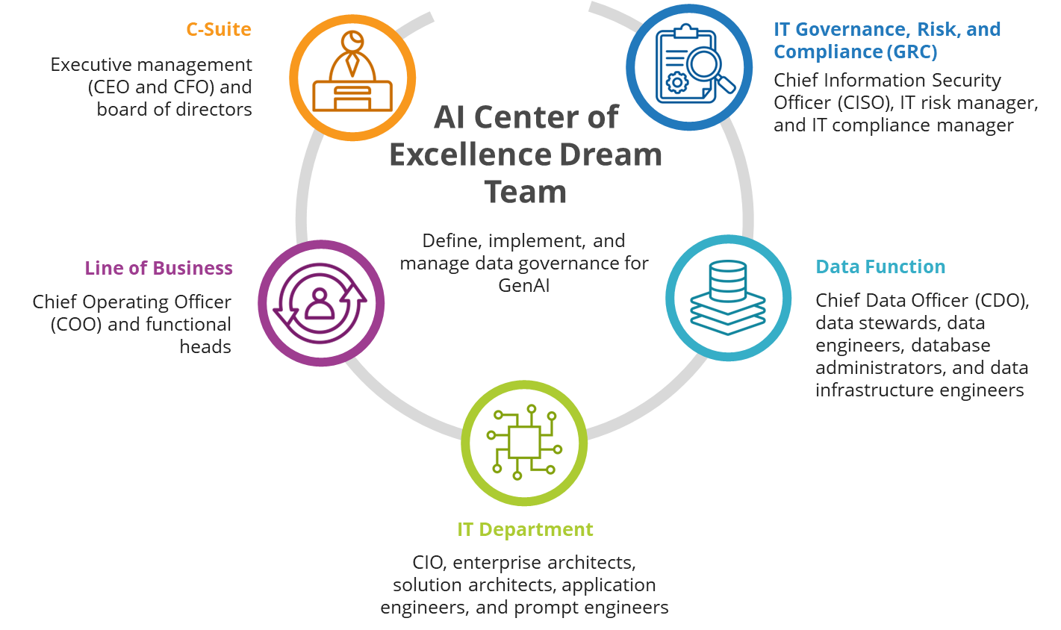

Key Personas in Governance
IT GRC
C-Suite
LoB
Data
IT
Persona Watch
Look for the icons and specific roles

Slide 4
What is AI governance? Why is it so hard?
IDC defines AI governance as "A system of laws, policies, frameworks, practices, and processes that enable an organization to implement, manage, oversee, and regulate the development, deployment, and use of AI technology, while managing AI risk."
#1
Reactive. The pace at which AI initiatives are emerging, and the lack of strategic involvement in governance, means most governance activities are unplanned and uncoordinated.
#2
Complex. The number of elements involved in AI governance is daunting, ranging from technical, ethical, legal, social, cultural, and financial aspects. Organizations often don't know where to start and where to prioritize efforts.
#3
Resource-heavy. Resource constraints (time, budget, people) for governance slow down policy implementation. Lack of AI governance expertise (skills and experience) is a top 3 impediment for enterprises.
Source: IDC's Future Enterprise Resiliency & Spending Survey — Wave 7, July 2024 (n = 891). Which aspects of AI governance do you consider as the most significant barriers to AI adoption in your organization? (Top 2 answers)

Slide 5
IDC's Unified AI Governance Model
Organization & Culture
Strategy & Oversight
Monitor
Assess
Operate
External Influences
Laws & Regulations
Standards, Guidelines, & Principles
Societal & Ethical Considerations
Responsible AI
Accountable with HITL
Transparency
Fairness & Lack of Bias
Explainability & Reliability
Infrastructure
Applications
Data
AI Platform
AI Technology Architecture
Compliance
Security & Resilience
Privacy Protection
Notes:
AI governance is multifaceted, and you need a unified AI governance model that encompasses not only the technical governance elements, but also ethics, principles, compliance, and other stakeholder concerns.
This is IDC's framework for how we recommend you think about a unified governance model.
External Inputs. Your AI strategy will be influenced by laws, corporate guidelines and influential stakeholders. Your AI governance supports your organization's ability to address these inputs. The place this occurs is in your strategy.
Strategy and Oversight. This is why your AI governance needs to be part of strategy, which is also linked to your corporate ethics and principles.
Organization and Culture. It must also be linked to your organization and culture.
AI Tech Architecture. At the heart of your AI governance is your AI technology architecture. It consists of AI system components such as data, apps, platforms, and infrastructure. Each one of these parts needs its own governance as it relates to AI.
Governance Processes. Any governance needs the processes to support it.
Assess the risk associated with AI as it relates to security, compliance, digital sovereignty, and third parties.
Operate your AI systems, algorithms, and data.
Monitor your operations through metrics and audits
You are free to start your AI governance journey from any of these parts of the framework. The challenge we see is organizations digging into one part and not addressing the entire framework. Data integrity is one such example – when we survey on governance, 40% of organizations tell us they are focused on data integrity and model transparency. But this is just one part of the overall unified governance model.
If executed well, you output will be responsible AI – AI that:
Is transparent & explainable
Has accountability and & includes human in the loop
Reliable
Supports diversity & fairness

Slide 6
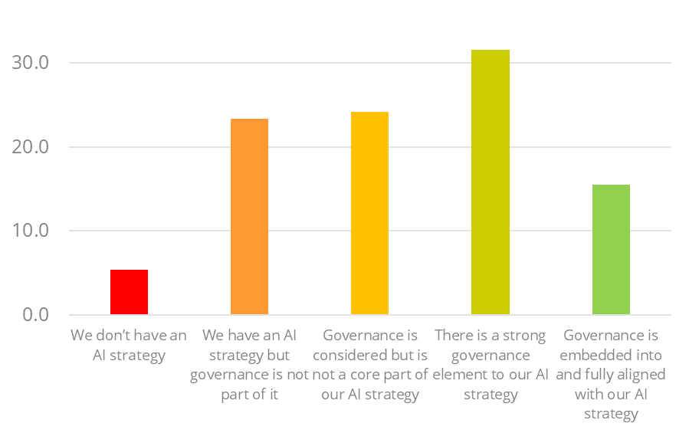
Strategy & Oversight: Governance is Strategy Enterprises are linking strategy to governance, but full alignment is far off for most.
CEO
CIO/CTO
IT GRC
LoB
Have linked business strategy more closely to governance as a result of the adoption of AI technologies.
But only 15% have embedded governance into AI strategy.
40%
Source: IDC's Future Enterprise Resiliency & Spending Survey — Wave 7, July 2024 (n = 891). What specific changes to governance have been made as a result of the adoption of AI technologies? Which of these statements best describes the extent to which your AI governance activities are aligned with your AI strategy?
Notes:
We think enterprises should focus on three high-level priorities
Governance needs to be part of strategy. Governance without strategic alignment is regarded as a burden and has no sense of prioritization. Strategy without governance lacks the guardrails and enforcement that ensures risk-managed execution. For example, use case selection without governance consideration may expose the enterprise to unacceptable risk on inconsistency with its corporate values. AI governance also interplays with overall corporate governance, just as corporate governance forms a key part of an enterprise's strategy. 40% of enterprises have "linked our business strategy more closely to our governance framework." But the linkage between AI strategy and governance is less clear:
Enterprises need a unified AI governance model that encompasses not only the technical governance elements, but also ethics, principles, compliance, and other stakeholder concerns. To operate efficiently, without duplication and in consistent adherence to corporate values, enterprises must connect each governance element and coordinate activities and desired outcomes. Currently, enterprises approach governance in a piecemeal manner (graph from Table 36 Wave 7)
Governance-by-design needs to be embedded not only in strategy, but also in business operations, to ensure delivery of trusted AI services at lower risk. Governance should be considered at the inception of any AI initiative, ensuring governance is built into AI systems from the ground up.

Slide 7
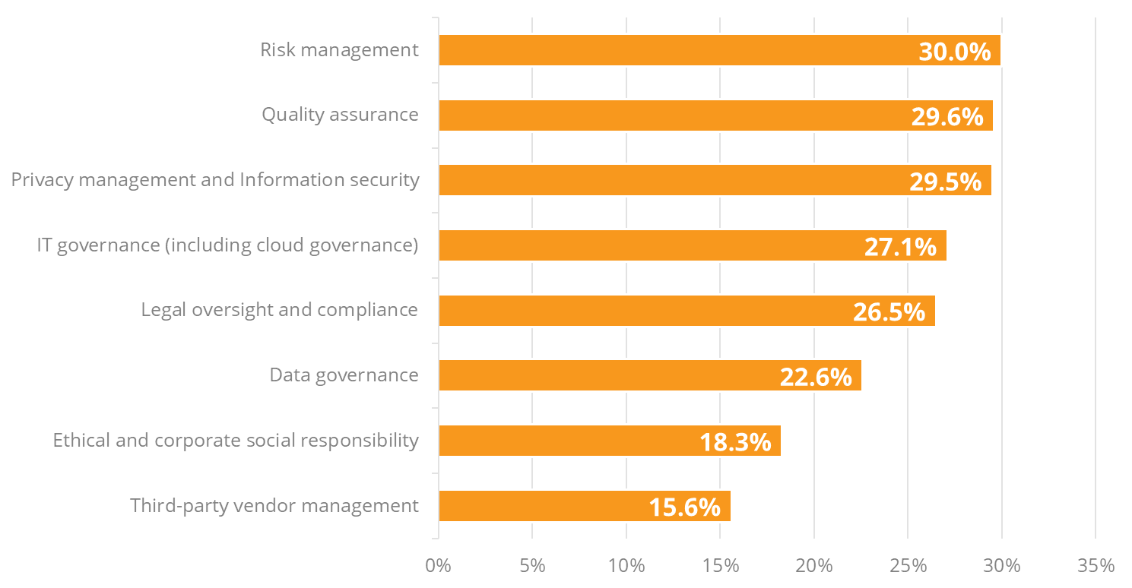
Governance is fragmented by nature
Which existing governance programs in your organization are being utilized to guide and manage your AI risk and governance strategy?
AI governance can overwhelm organizations, as they don't know where to start, how to meld the various elements of governance together, and where to prioritize efforts. Enterprises may start their AI governance journey from any of these existing governance programs; the challenge is to unify the various parts of governance into one cohesive approach. Lead with strategy, prioritize the important elements, and expand your governance approach to eventually encompass all elements.
Prioritization is key, but it must be done in conjunction with the enterprise's risk appetite. At minimum, have security, data governance, and compliance at the top of your to-do list.
Source: IDC's Future Enterprise Resiliency & Spending Survey — Wave 7, July 2024 (n = 891).
Notes:
Governance elements include external factors such as laws and regulations; strategic inputs such as ethics, principles and use cases; organizational and cultural inputs such as corporate values, societal norms and AI literacy; assessment tasks such as AI visibility and risk assessment; monitoring aspects such as metrics and audit; operational facets such as compliance, security and human oversight; and the governance of the AI system components themselves (data, apps, platforms and infrastructure). The output from a functioning governance program is responsible AI, a set of seven principles that collectively mitigate risk associated with AI.
Prioritization is key, but it must be done in conjunction with the enterprise's risk appetite. At minimum, have security, data governance, and compliance at the top of your to-do list.

Slide 8





Organization & Culture
CEO, CHRO, COO,
Chief Ethics Officer
Organizational culture is the shared beliefs, values, and behavior that characterize a company and guide its actions.
Every company has an organizational culture, even if they do not actively define or recognize it.
Governance, of the execution of it, will always reflect the actual culture of an organization.
45%
align governance with vision for responsible innovation or integrate governance with mission to improve the world, exceeding regulations.
Key Elements of Culture in AI Governance
People
Goal: To ensure the right mindsets, skills, and behavior around AI.
Literacy
Goal: To build broad understanding of AI capabilities, limitations, and potential impacts across the organization, not just technical AI skills to enable more informed and responsible decision-making around AI.
Communication
Goal: To foster organizationwide awareness and understanding of AI initiatives, policies, and their rationale.
Engagement and Feedback
Goal: To establish continuous feedback loops and accountability mechanisms to involve all stakeholders in the AI governance process.
Only 21%
of organizations worldwide say there is cultural resistance to AI-governanance-related changes.
Source: IDC's Future Enterprise Resiliency & Spending Survey — Wave 7, July 2024 (Base = Respondents indicated organization having an AI strategy, n = 624)
Notes:
Organizational culture is a fundamental driver in how a company operates and makes decisions, also in the context of AI governance. This culture, comprising shared beliefs, values, and behavior, is critical for fostering responsible AI practices. Every organization has a culture, whether consciously cultivated or not, and this culture can significantly impact the effectiveness of AI governance.
A crucial aspect of aligning AI governance with an organization's broader mission and vision is ensuring that governance is not just about compliance, but also about promoting responsible innovation. Many forward-thinking organizations are integrating AI governance into their mission to exceed regulatory requirements. This approach helps in building trust and credibility, both internally and externally.
Interestingly, only 21% of organizations worldwide report cultural resistance to AI governance-related changes. This suggests that there is growing recognition of the importance of AI governance and a willingness to embrace it. However, this also highlights that a significant number of organizations may still need to overcome internal barriers to fully integrate AI governance into their culture.
Key elements that influence AI governance include:
People. The focus is on developing the right mindsets, skills, and behavior toward AI. This includes not only technical expertise but also ethical considerations and an understanding of AI's societal impacts. Challenges in this area include overcoming resistance to change, addressing the lack of AI literacy, and breaking down siloed working practices.
Literacy. Building a broad understanding of AI's capabilities, limitations, and impacts across the organization is essential. This understanding must extend beyond technical skills to encompass a more holistic view of AI's role in the organization and society. However, the technical complexity of AI and the lack of cross-functional understanding are significant challenges.
Communication. Effective communication is key to fostering organizationwide awareness and understanding of AI initiatives and policies. Clear communication ensures everyone in the organization understands the rationale behind AI governance decisions, helping to build trust and transparency. The main challenges here include overcoming poor information sharing and ensuring transparency.
Engagement & feedback. Establishing continuous feedback loops and accountability mechanisms is vital to involve all stakeholders in the AI governance process. Active engagement helps ensure AI governance reflects diverse perspectives and is responsive to the needs of various stakeholders. Challenges include overcoming siloed decision-making and ensuring sufficient user or stakeholder input.
In addition, balancing centralization and decentralization in AI governance is critical. While a centralized approach can enhance efficiency, it may overlook local contexts and stakeholder needs. Conversely, a decentralized model can better reflect diverse perspectives but might struggle with maintaining alignment and consistency.
The adage "Culture eats (AI) strategy for breakfast" underscores the reality that without the right organizational culture, even the most well-thought-out AI strategies are likely to falter. Real culture always shines through, and if the underlying culture does not genuinely support responsible and ethical behavior, no amount of governance can effectively mask or correct it. Strict governance alone cannot compensate for a culture that is misaligned with responsible practices. Therefore, establishing a culture aligned with responsible AI principles is essential for sustainable governance. This alignment goes beyond merely meeting regulations; it involves setting a higher standard for responsible innovation that is deeply rooted in the organization's values.
Key roles — including the CEO, CHRO, COO, and potentially a Chief Ethics Officer — play significant parts in managing and driving this cultural alignment. Developing the right skills, fostering open communication, and embracing a mission of responsible innovation are all vital components of a culture that supports ethical AI governance.

Slide 9
External Influences
External factors are shaping AI governance, compelling organizations to adapt their strategies to meet evolving regulatory, societal, and market demands.
Laws and Regulations
Emerging AI regulations such as the EU AI Act and U.S. state laws are directly shaping AI governance practices. Regulation can act as an accelerator by fostering trust and addressing risks and an inhibitor by potentially slowing down innovation.
The interplay between AI regulation and data protection laws such as the GDPR and CCPA aim to ensure responsible AI use by safeguarding personal data and upholding privacy rights.
International Standards
Standards ensure consistency and facilitate global alignment. Two emerging standards for the enterprise are ISO 42001 and the NIST AI Risk Management Framework.
Societal and Ethical Considerations
94%
agree that laws and regulations governing the use and development of AI are necessary.
Public opinion amplified by media and advocacy groups is a potent force in shaping AI governance. AI concerns focus on issues such as bias, job displacement, misinformation, and privacy.
Collaboration between industry and academic bodies to create ethical frameworks to ensure AI development and deployment is transparent, accountable, and beneficial for society.
AI Guidelines and Principles
Prominent non-binding responsible AI frameworks by public institutions include OECD AI Principles, Hiroshima G7 AI Process, and the UNESCO Recommendation on the Ethics of Artificial Intelligence.

Slide 10
Assess
The Assess function creates a detailed inventory of AI systems within an organization, evaluates the associated risks and impacts, and informs decisions on whether to proceed with the design, development, or deployment of each AI system. This is not a one-off exercise but an ongoing process cycle.
Key Identify Activities
Key Assessment Activities
Identify and document each AI model, detailing its purpose, architecture, and key characteristics. This includes specifying where each model is deployed, training procedures, its inputs and outputs, and its interactions with other systems.
Identify known and foreseeable negative impacts for all components of the AI system throughout its life cycle, including third-party software and data.
Assess likelihood, magnitude of impact, and risk to individuals, communities, organizations, society, and the environment.
Establish audit trails for data and content flows within AI systems, documenting sources and types of training data, data lineage, content provenance, any fine-tuning processes applied, potential biases, and criteria used in decision-making.
Organizations should have sufficient contextual risk information to select the most appropriate risk treatment option: tolerate, reduce, or avoid. Document tradeoffs, decision processes, and relevant measurement and feedback results.

Slide 11





Operate
The Operate function entails implementing risk management controls, processes, and resources to mapped AI risks on a regular basis and in accordance with established organizational risk tolerances, along with procedures for continual improvement.
Implement AI risk controls across the following responsible AI outcomes:
1
Establish processes to identify risk indicators in third-party systems or components.
Compliance
Privacy protection
Security and resilience
Transparency
Fairness and lack of bias
Explainability
Accountability and human in the loop
Incorporate human review processes to evaluate and filter content in line with organizational and ethical values and to identify nuances that automated processes might miss.
2
Processes for responding to and recovering from incidents and errors are established, including contingency processes for handling negative impacts associated with mission-critical third-party AI systems.
3
4
Procedures are in place to deactivate AI systems that fail to meet the organization's performance standards or risk tolerance levels.

Slide 12
Monitor
The Monitor function is a continuous process of measuring all governance performance against strategic AI goals. It involves the definition and gathering of a variety of metrics, reporting on these metrics at regular intervals to senior management, and auditing. A key aspect of monitoring is the assessment of outcomes and the establishment of feedback loops to improve success.
There is a wide range of metrics that enterprises may wish to monitor. Categories of metrics and examples include:
Model accuracy. Retrieval quality, relevance
Performance. Intent, speed, data quality
Cost. Compute spend, cost-per-prompt, cost-per-model
Responsible AI outcomes. Prompt injections, private data, toxicity
Third-party performance. Brand & regulatory risk
Alignment with corporate governance metrics. Ethical behavior, stakeholder engagement, risk oversight
Enterprises will likely want to gather metrics across their entire AI estates, but collecting and monitoring such a wide variety of data is a challenge. No one governance system will capture all required data; integrating disparate data sources remains difficult, and enterprises may want to retain separate monitoring anyway for efficiency and operational reasons.

Slide 13


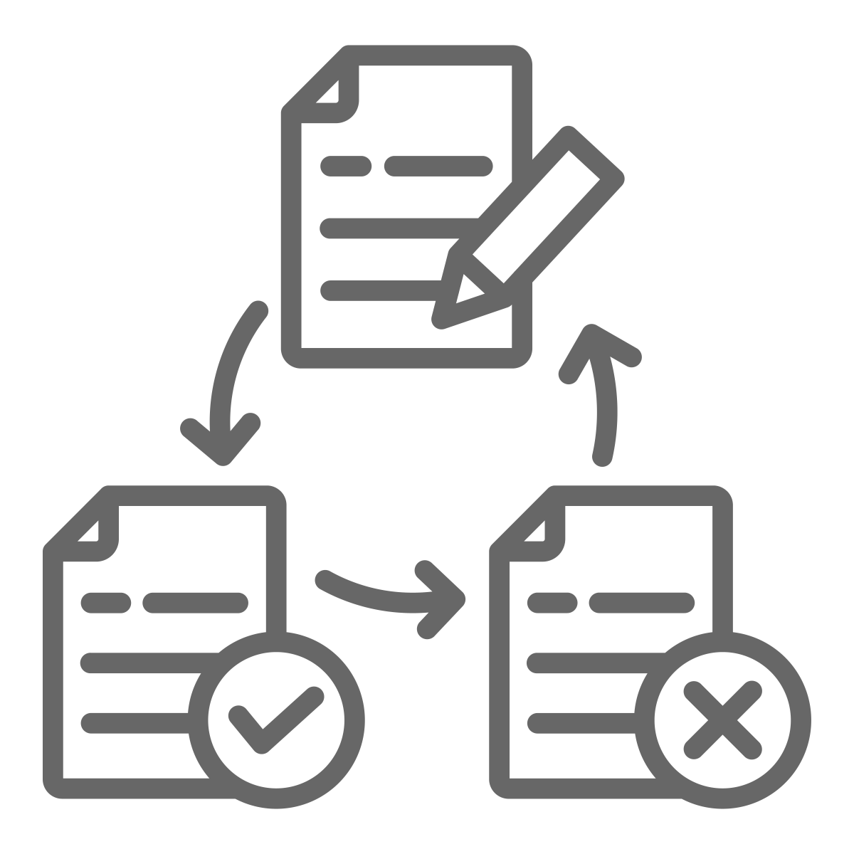

Data Governance
Chief Data Officer, DBAs,
data stewards
Key Elements of a Data Governance Approach
Data Quality and Integrity
In examining the quality of data, we also evaluate accuracy of the dataset, the completeness of dataset (are there critical variables necessary for our analysis and if data proxies are being used, what justifies this replacement), and the timeliness of the dataset. Data collected 10 years ago may have little utility today, depending on the use case.
Data Life-Cycle Management
Life-cycle management is a critical communication point for customers and partners. Organizations should review how and why data is collected, how and why data is being stored, provide guidelines on how data can be used, as well as detail what data is retained or deleted, and the manner of retention and/or deletion.
Data Privacy and Security
This encompasses how well data collection practices are adhering to legal standards and other contractual obligations. Governance teams should also continuously review who is authorized to access different datasets and why, and ensure data is encrypted in transit and at rest.
Ethical Considerations
Datasets should be evaluated for bias and inclusion, appropriate to the use case. Transparency on when the data was collected, from whom, and how obtained and consented are also important criteria.

Slide 14
Data Governance
Data intelligence is a critical aspect of data governance. Organizations should be able to answer:
Who is using what data?
Where is data, and where did it come from?
When is data being accessed, and when was it last updated?
Why is this data being collected? What are the possible arguments for both retention and erasure of this data?
How is this data being used?
What relationships are inherent within this data and with data consumers?
Most organizations need to revisit and revise their current data governance approach to enable the use of AI and GenAI technologies, as 29% of organizations have made significant changes to their data governance policies as a result of AI adoption.
50%
of companies say data security and compliance are the top infrastructure-related concerns hampering their ability to move AI from proof of concept to production.
But only
22%
are utilizing their existing data governance programs to guide their AI risk and governance strategies.
Source: IDC's Future Enterprise Resiliency & Spending Survey — Wave 7, July 2024 (n = 891).

Slide 15
Platform Governance
GRC, CISO, IT Risk Mgr,
IT Compliance Mgr
Bias Detection and Mitigation
A new class of AI governance platforms are emerging to assist with monitoring and managing AI systems.
In evaluation of these platforms, organization should consider:
Business alignment
User experience
Integration capabilities and API support
Security and compliance of the platform
Performance and reliability
Cost and ROI
How data is managed by the platform and what data is managed
Sustainability and corporate social responsibility
That an appropriate abstraction API layer provides the necessary plug-and-play components to switch out AI models as needed
Ensure the presentation layer maintains separation from the abstraction layer such that the user experience is not impacted by changes
Model Monitoring and Validation
AI Governance Platform Capabilities
Compliance
Transparency and Explainability
Data Privacy and Security

Slide 16
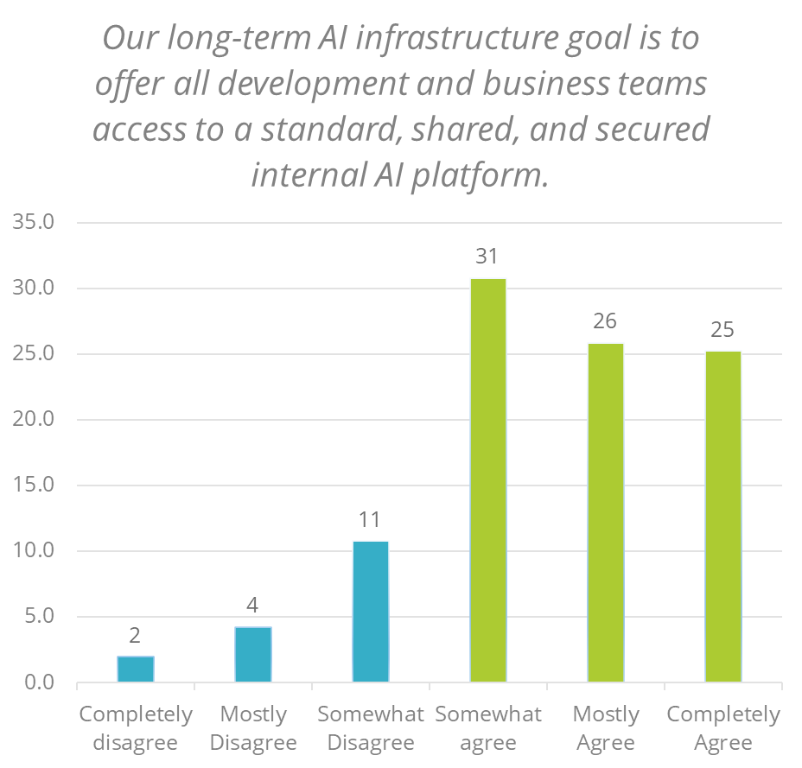
Application Governance
IT GRC
C-Suite
LoB
Application governance is similar to platform governance, but caution is advised — not all applications may adhere to local regulations and requirements, depending on the enterprise vendor. Organizations should confer with the enterprise partner if questions remain. The ease of application deployment may also be an area of concern. Organizations should ensure policies are clear and that all applications are reviewed and assessed internally before deployment.
Key questions include:
What are your current processes?
Which is the right enterprise partner for your organization's needs?
Do you have a change management process in place?
Do I incorporate AI governance as part of my existing DevOps or DevSecOps teams and processes?
Do I create a separate AIDevOps or AIDevSecOps function to act as a clearinghouse for all AI application efforts?
What are the appropriate operational metrics that I need to build into my AI models to demonstrate governance functions produce the proper results?
Data
IT
Source: IDC's Future Enterprise Resiliency & Spending Survey — Wave 7, July 2024 (n = 891).

Slide 17
Infrastructure Governance
IT GRC
Data
CIO/CTO
IT SM & Ops
Infrastructure governance considerations include:
Security and access control
Workload assessment and appropriate deployment options and operating models
Resource usage and consumption permissions and monitoring
Change management
Cost visibility and management (FinOps)
Sovereignty considerations
Many organizations experiment with GenAI by using free or low-cost public cloud services. As a result, they are largely unaware of the true cost of the compute, storage, and networking infrastructure needed to support GenAI applications running at large scale for production use cases. Governance is also often not considered (fully or at all) at this exploratory stage.
Half of enterprises cite data security and compliance as a top infrastructure concern
50%
Source: IDC's Future Enterprise Resiliency & Spending Survey — Wave 7, July 2024 (n = 891). What are the top 3 infrastructure related concerns hampering your organization's ability to move AI from proofs of concept (POCs ) to production use?
Reference: IDC PlanScape: Governance for Generative AI Digital Infrastructure Deployment (IDC #US51186923, September 2023)

Slide 18





Sustainable AI Governance Considerations
IT GRC
25%
of organizations state sustainability concerns related to power and cooling costs are hampering their organizations' ability to move to AI production
C-Suite
LoB
Data
IT
Datacenter Efficiency
Hardware & Sustainable Procurement
Policies & Regulations
Ethical Development
Energy consumption
AI relies on datacenters that consume large amounts of energy to compute as well as cool. Water-cooled systems add additional environmental considerations for areas that are water-scarce.
Sustainability regulations and policies governing carbon emissions will collide with regulations governing the privacy of and ethical use of AI and of data products, complicating adoption.
AI systems must be ethically developed using data that has been ethically collected, and ensure fairness, transparency, and accountability. Greater detail can be found on the next slide.
AI-enabling hardware involves the use of rare-earth materials, necessitating more circular and sustainable supply chain ecosystems.
Training and utilization of models increases energy consumption, leading to high carbon emissions.
On Sustainable AI: Research conducted by Alex de Vries at Vrije University in Amsterdam estimates that Nvidia will ship 1.5 million AI server units per year by 2027, and that 1.5 million servers running at full capacity can consume at least 85.5 terawatt-hours (TWh) of electricity annually — more than the annual energy consumption of many small countries, troubling efforts to reduce carbon emissions. AI-enabled hardware, model optimization, and higher quality data will mitigate energy consumption, but it will add costs to AI deployment and usage. Organizations must incorporate these additional costs into their AI strategies as well as request energy-use disclosures from AI developers.
Source: IDC's Future Enterprise Resiliency & Spending Survey — Wave 7, July 2024 (n = 891).

Slide 19



Responsible AI
CEO, COO, CIO/CTO,
Chief Compliance Officer/Chief Counsel,
CISO, Chief Ethics Officer
Responsible AI allows for high-quality, impactful decision-making while mitigating risks, ensuring compliance, and building trust externally with customers and stakeholders as well as internally within the organization.
Seven Pillars of Responsible AI as an outcome of AI Governance
Accountability and Human in the Loop Ensuring clear ownership and human decision-making authority over AI systems to maintain trust, prevent harm, and align AI with human values.
Transparency Revealing AI's inner workings to build confidence and enable scrutiny, essential for responsible deployment.
Fairness and Lack of Bias
Creating AI systems that treat all equitably, preventing discrimination and unfair outcomes to uphold justice.
Explainability and Reliability Ensuring transparent AI reasoning and consistent performance to build trust, enable accountability, and empower stakeholders to address potential issues.
Compliance
Adhering to all relevant AI laws and regulations to protect organizations and the public from legal and reputational risks.
Privacy Protection Carefully managing AI data to respect individual privacy, build trust, and uphold fundamental rights.
Security and Resilience Implementing robust safeguards to prevent AI manipulation and failures, ensuring system reliability and averting potential catastrophes.
ADDRESS
All seven elements should be addressed to ensure responsible AI implementation.
PRIORITIZE
Organizations may prioritize certain responsible AI pillars based on their business needs.
ASSESS
Implement a feedback loop to continuously align outcomes with expectations, allowing for iterative refinement of AI practices and principles.
Notes:
Responsible AI is essential for organizations seeking to leverage the power of artificial intelligence while minimizing associated risks. By embedding ethical principles into AI governance, organizations can ensure impactful, high-quality decision-making. This approach is crucial for maintaining compliance, mitigating risks, and building trust with customers, stakeholders, and within the organization. The concept of Responsible AI is defined by seven key pillars, each representing a critical outcome that should be planned for and expected from effective AI governance.
Seven Pillars of Responsible AI
Accountability and Human in the Loop
Accountability is the cornerstone of Responsible AI, ensuring there is clear ownership and well-defined decision-making processes for AI systems. This pillar emphasizes the necessity of meaningful human oversight, in which humans can override automated decisions when needed. Maintaining accountability is crucial for building trust and ensuring that AI remains aligned with human values, preventing potential harm from unmonitored AI operations.
Transparency
Transparency involves providing visibility into the data, models, and decision-making processes underlying AI applications. This pillar builds confidence among stakeholders and customers by enabling the scrutiny needed to ensure AI is deployed responsibly. Transparency is vital for fostering trust and enabling informed decision-making by those impacted by AI-driven outcomes.
Fairness and Lack of Bias
Fairness in AI is about designing systems that treat all individuals and groups equitably, without discrimination based on protected characteristics. This pillar is essential for upholding principles of justice and preventing biased or unfair outcomes. Ensuring fairness and lack of bias in AI supports ethical standards and guarantees that AI-driven decisions are just and equitable for all.
Explainability and Reliability
Explainability requires making the reasoning behind AI decisions clear to users and stakeholders, while reliability ensures consistent performance and outcomes. These aspects are critical for building trust, as they enable stakeholders to understand, monitor, and address potential issues within AI systems. Reliable and explainable AI is necessary for maintaining credibility and ensuring that AI applications remain accountable.
Compliance
Compliance ensures AI applications adhere to all relevant laws, regulations, and guidelines. This pillar protects organizations and the public from legal and reputational risks, making it a crucial component of Responsible AI. Adhering to compliance standards is vital for the ethical and lawful deployment of AI technologies.
Privacy Protection
Privacy protection focuses on respecting individual privacy by carefully managing the collection, use, and storage of data in AI systems. Safeguarding privacy is not only a legal requirement but also a moral obligation, building trust with individuals and upholding their fundamental rights. Effective privacy protection is essential for maintaining the integrity and ethical standards of AI applications.
Security and Resilience
Security and resilience involve implementing robust safeguards to prevent AI systems from being hacked, manipulated, or failing in ways that compromise safety. Ensuring secure and resilient AI is crucial for maintaining system reliability and preventing failures, whether minor or catastrophic. This pillar is essential for the sustainable and safe operation of AI systems, protecting both the organization and the public.
Address, Prioritize, and Assess
To ensure the successful implementation of responsible AI, all seven pillars must be addressed comprehensively. Ignoring any single pillar can expose an organization to significant risks and undermine trust in their AI systems. While organizations may prioritize certain pillars based on their specific business needs, thorough assessment and prioritization should occur before developing an AI governance strategy. Ideally, these pillars should be embedded into the organization's culture, creating a continuous loop that allows for the reprioritization of outcomes, as necessary.
Responsible AI requires a governance approach that ensures accountability, transparency, fairness, explainability, compliance, privacy protection, and security. By addressing and prioritizing these seven pillars, organizations can implement AI systems that are ethical, sustainable, and aligned with both business objectives and societal values. This approach not only mitigates risks but also establishes a foundation of trust and integrity, which is essential for the long-term success of AI initiatives.
Key organizational leaders — including CEOs, CIOs/CTOs, and Chief Compliance Officers — play a pivotal role in driving the responsible AI agenda, ensuring it becomes a core aspect of the organization's strategy.

Slide 20
Guidance for Tech Buyers
Align governance with strategy. Neither is complete without the other. Don't forget culture — align internal values and practices with external AI ethics commitments.
Keep abreast of AI laws, regulations, and guidelines, including sustainability perspectives. Compliance is fast-evolving. Leverage existing embedded tooling toward an integrated end-to-end approach.
Invest in governance training and skills. A lack of AI governance expertise is a major impediment to AI adoption.
Notes:
IDC recommends to Tech Buyers that they:
Align governance with strategy. Neither is complete without the other. Beware of cultural misalignment; align internal values with external AI ethics commitments to avoid losing credibility. A misaligned culture can erode trust in your AI systems, both internally and externally. Ensure your organization's internal values match its external AI ethics commitments to avoid the risk of losing credibility with customers and stakeholders.
Keep abreast of AI laws, regulations, and guidelines. Compliance is fast-evolving, so use existing frameworks where they apply, such as NIST. Leverage existing embedded tooling toward an integrated end-to-end approach; adapt to maturing tech and laws. There is no end-to-end solution on the market today, but new tools will emerge, so watch out for these. But be aware that laws and regulations are also evolving, and you should check that any tools are consistent with your compliance obligations.
Invest in governance training and skills. A lack of AI governance expertise is a major impediment to AI adoption. Almost 30% of enterprises cite this as a major barrier to AI adoption.

Slide 21
Duncan Brown
dbrown@idc.com
+44 (0) 7903 669 706
@duncanwbrown
EUR152600024

